Slide 1
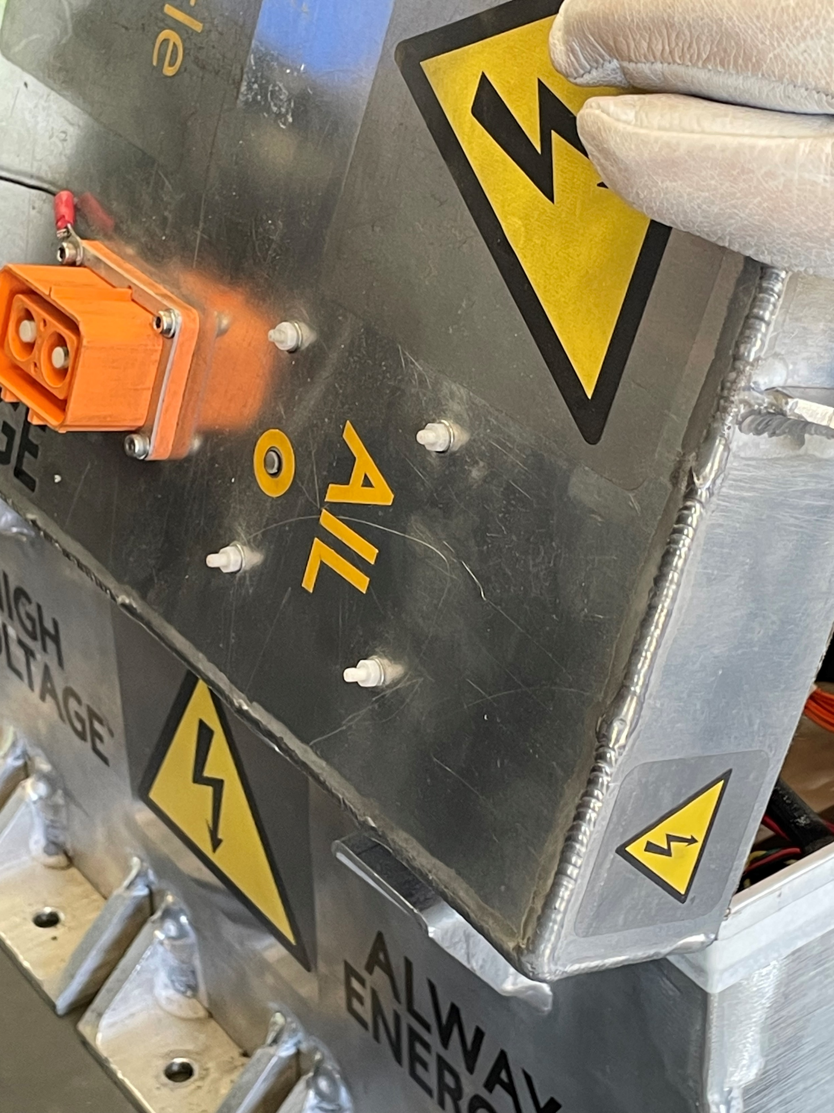
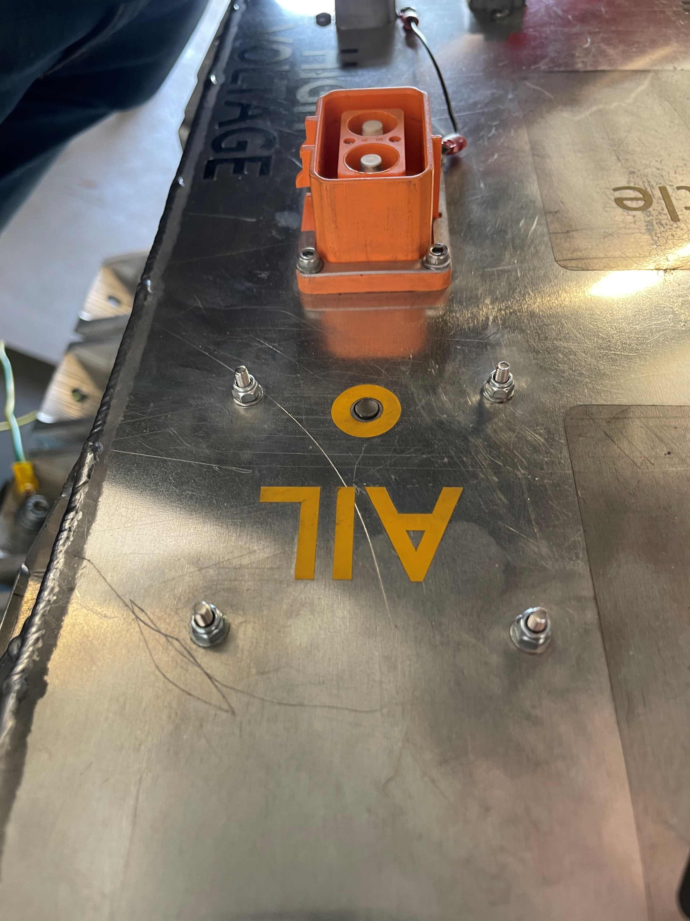
A
B

Slide 2
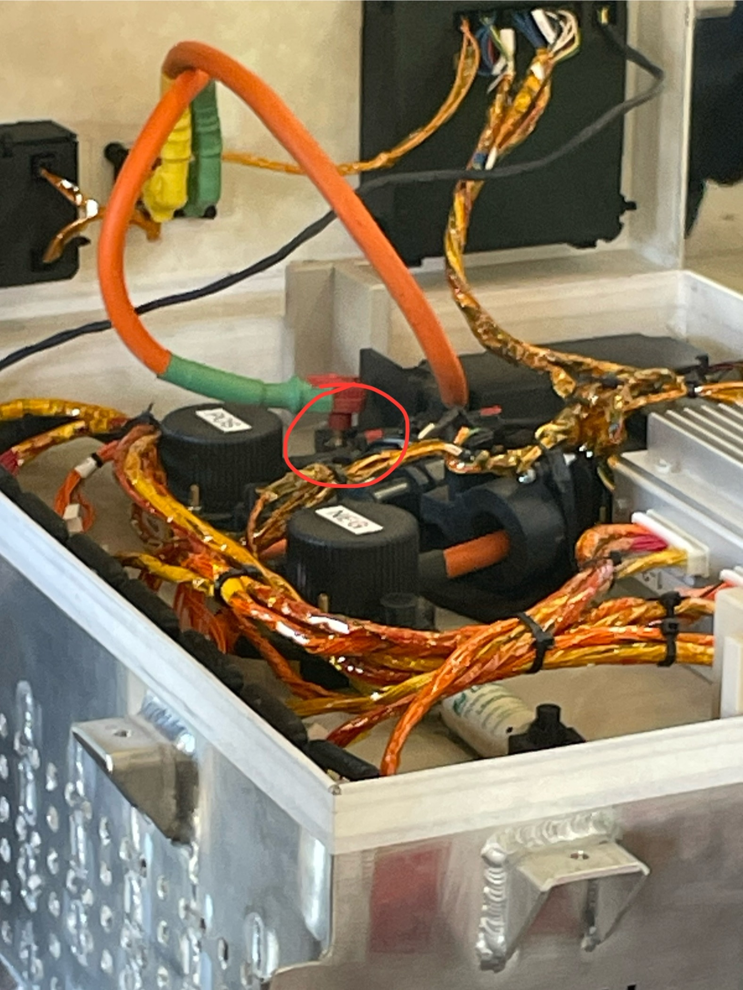
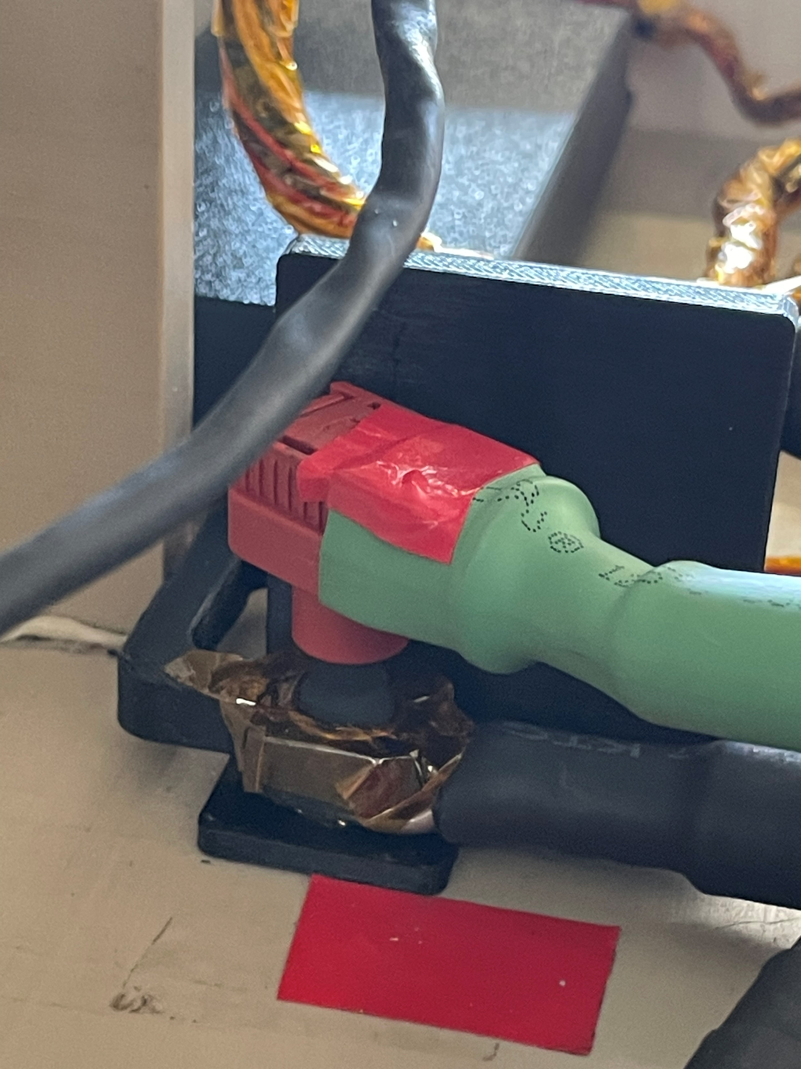
A
B

Slide 3
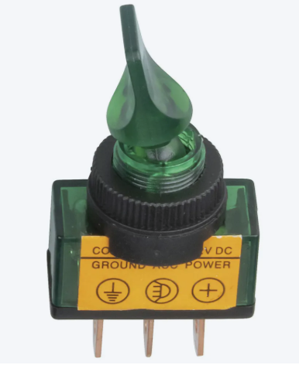
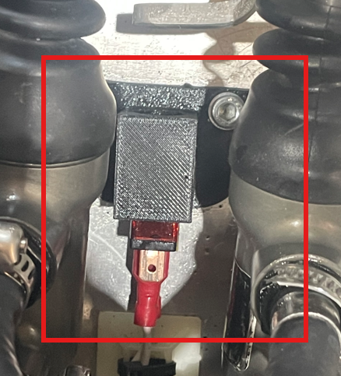
A
B
Location of frequent failure
Location of proper support, where it was not originally supported from
BOTS that was continually breaking

Slide 4
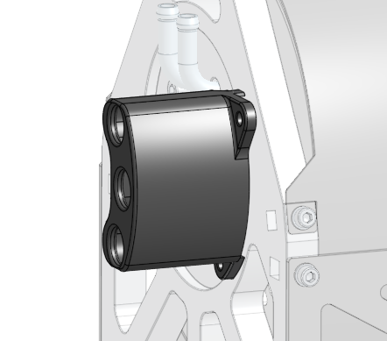
NOTE: phase cables are not modelled
Location of where cable glands could be placed

Slide 5
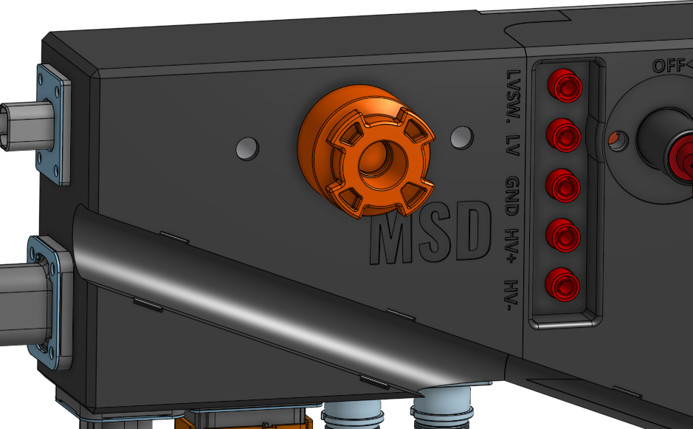
NOTE: bolts are not modelled
Location of bolts that should be positively locked

Slide 6
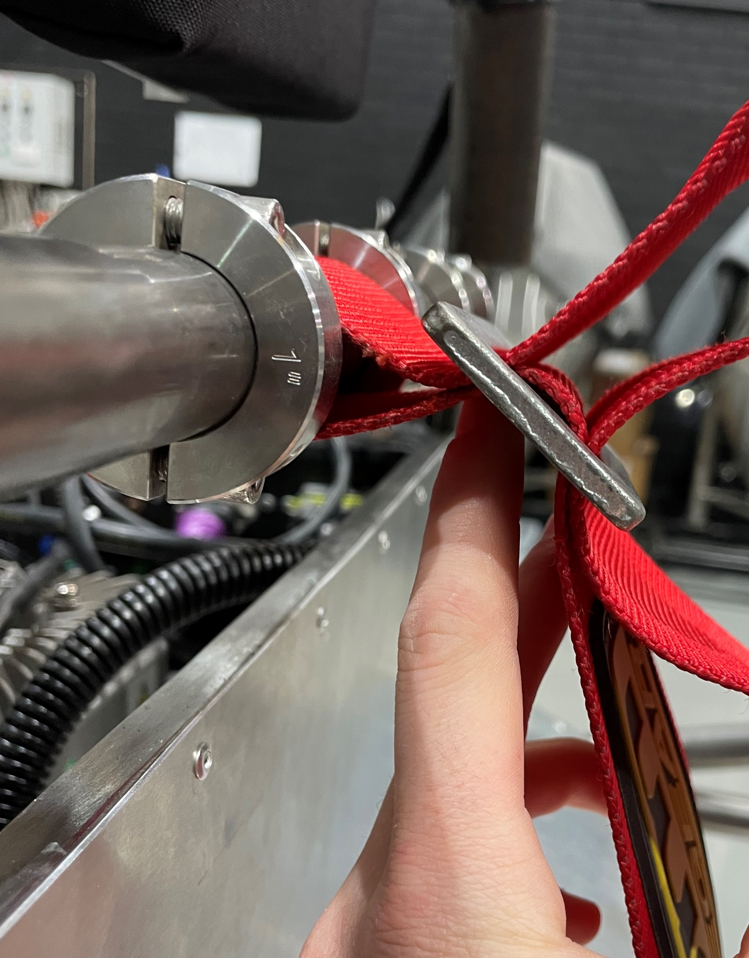
NOTE: the chassis is not powder coated in this image
Location seatbelt harness holders' locations

Slide 7
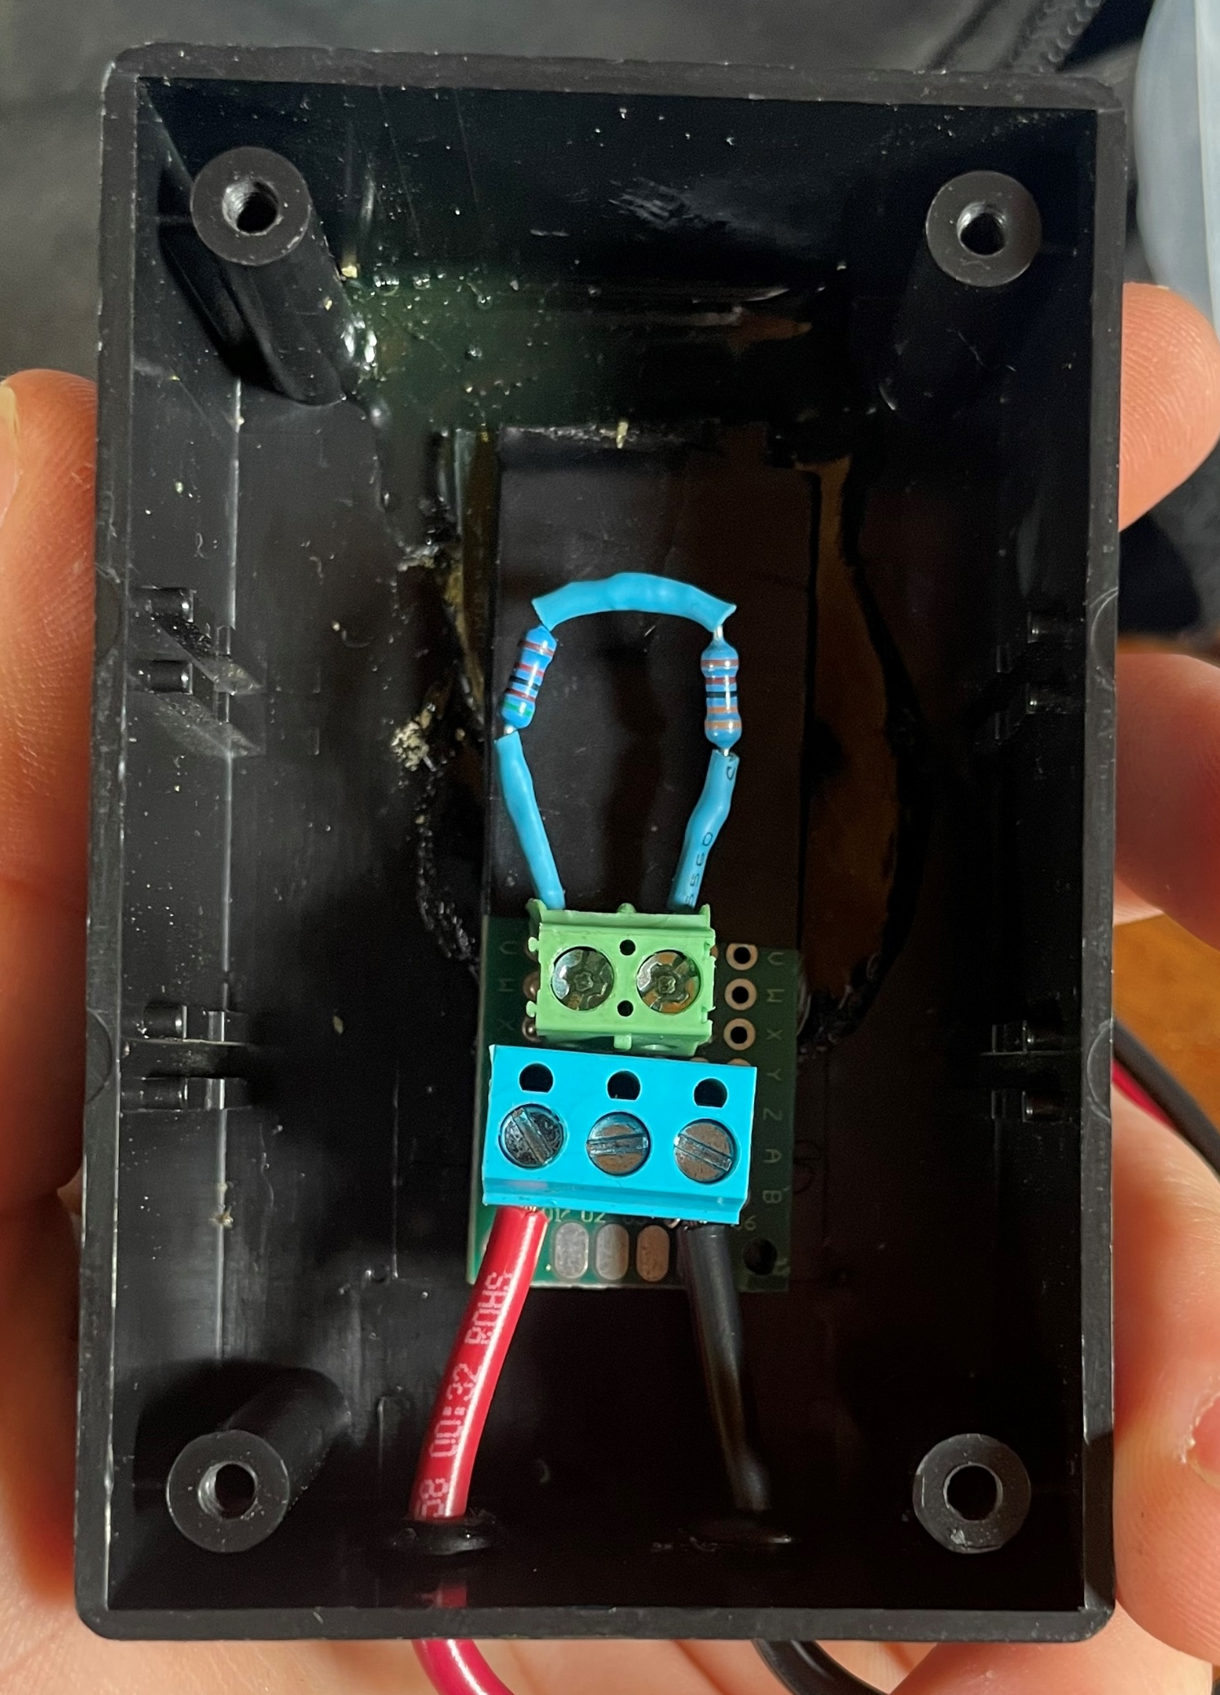
Series resistors
Screw terminals that were not rated for 500 V

Slide 8
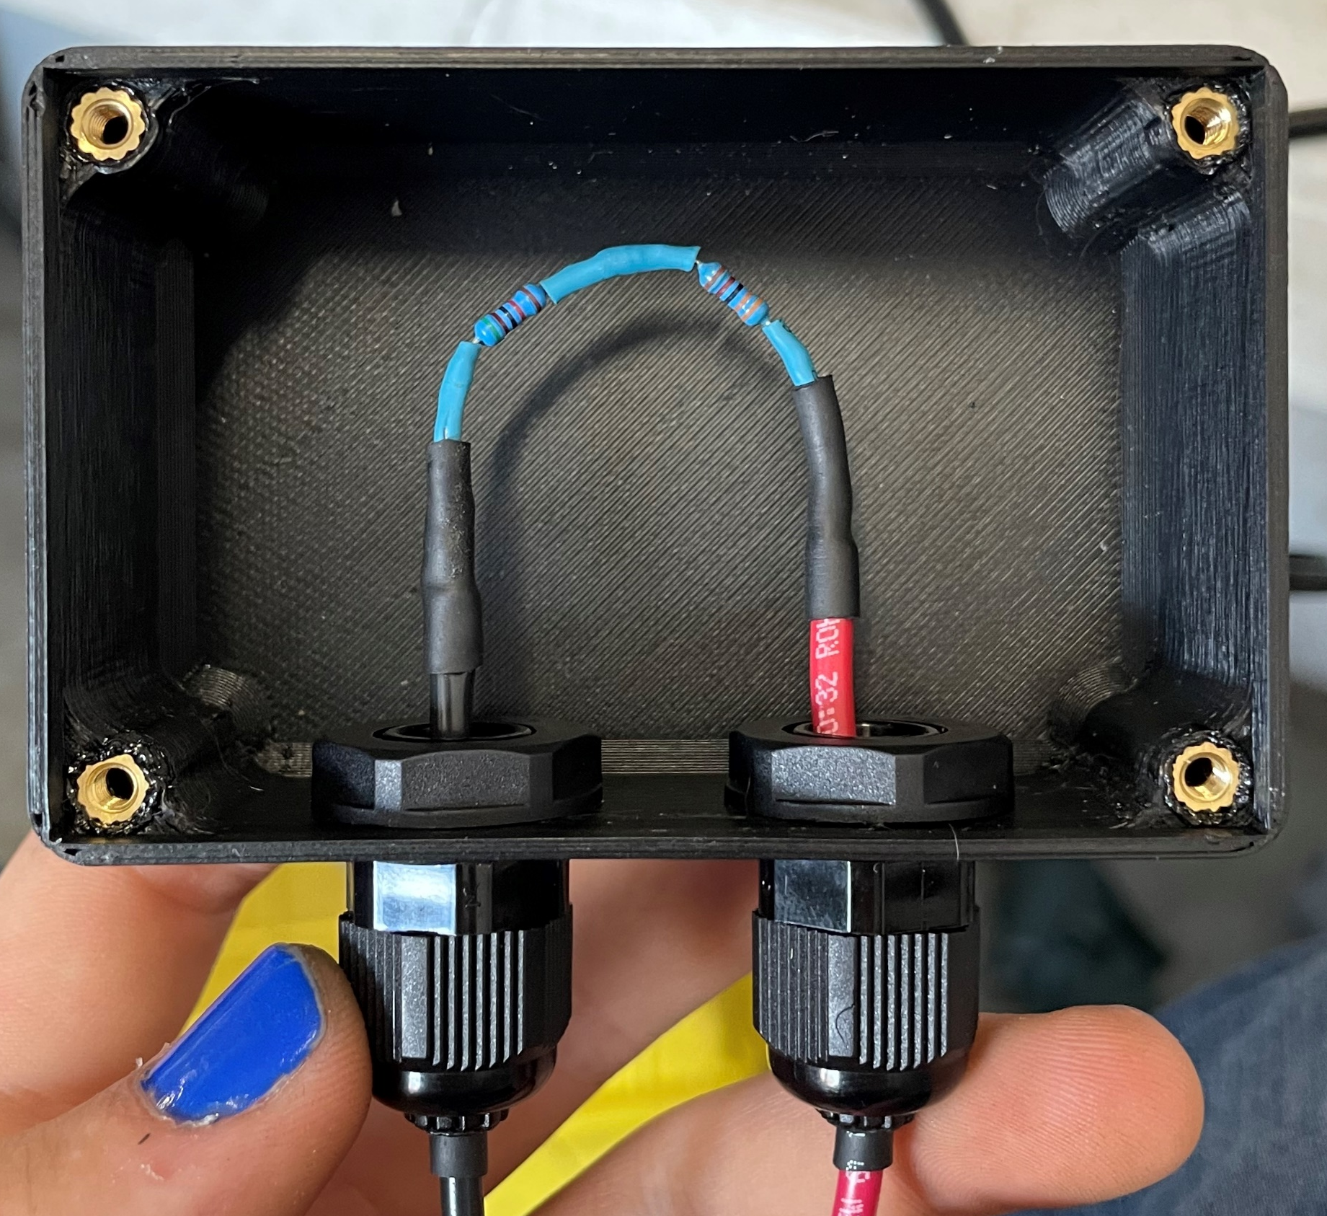
Soldered connection
NU Racing themed nails
Cable glands for retaining wires

Slide 9
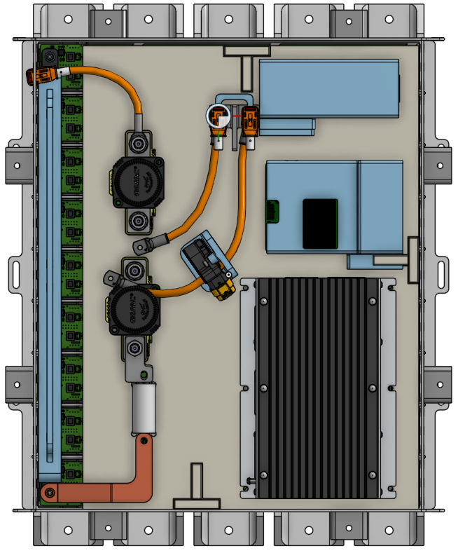
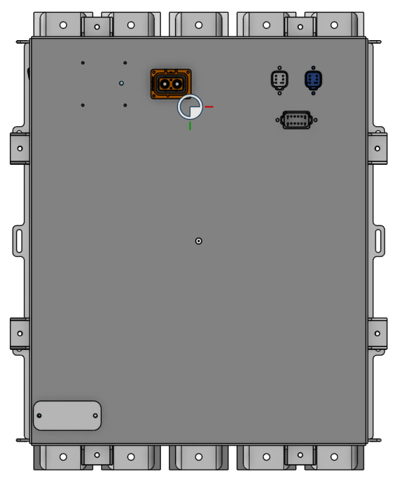
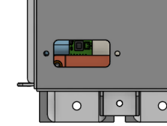
A
B
Viewing hatch
Mounting location of thermal strip
View through hatch when removed

Slide 10
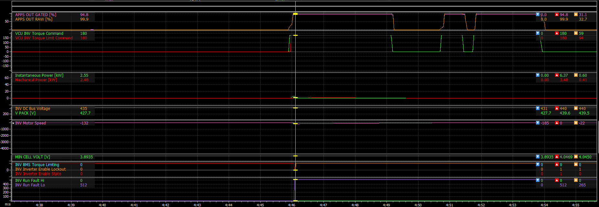
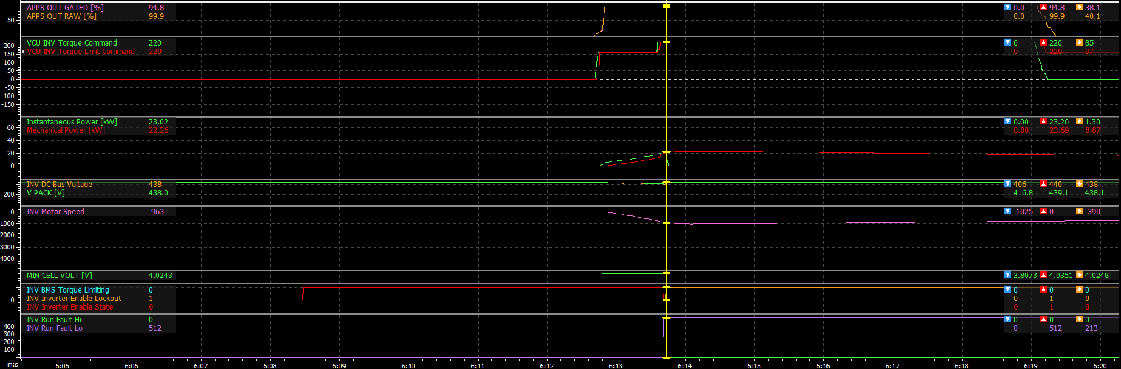
A
Moment of fault
160 Nm
220 Nm
0 Nm
B
Moment of fault

Slide 11
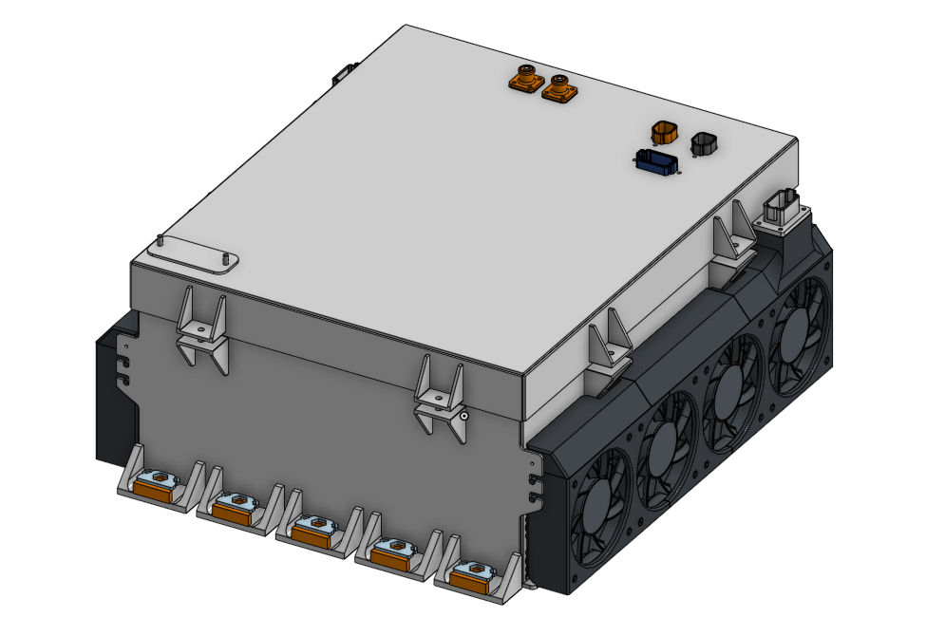
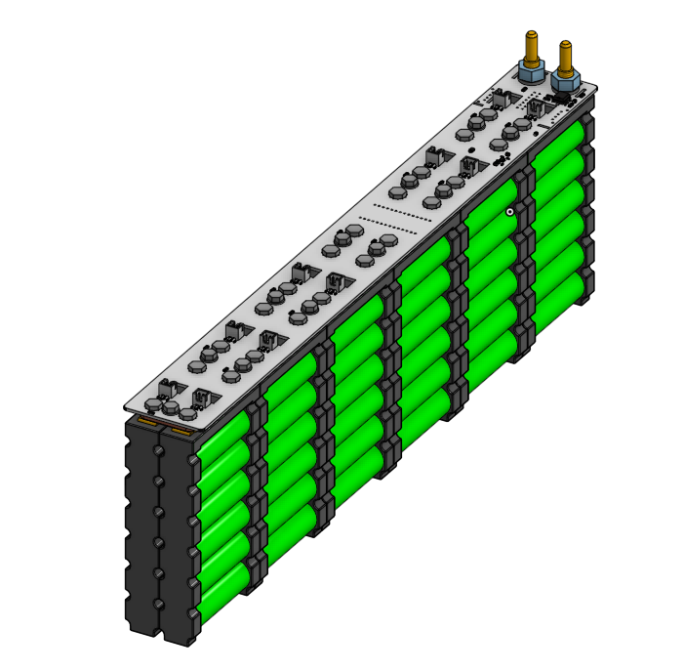
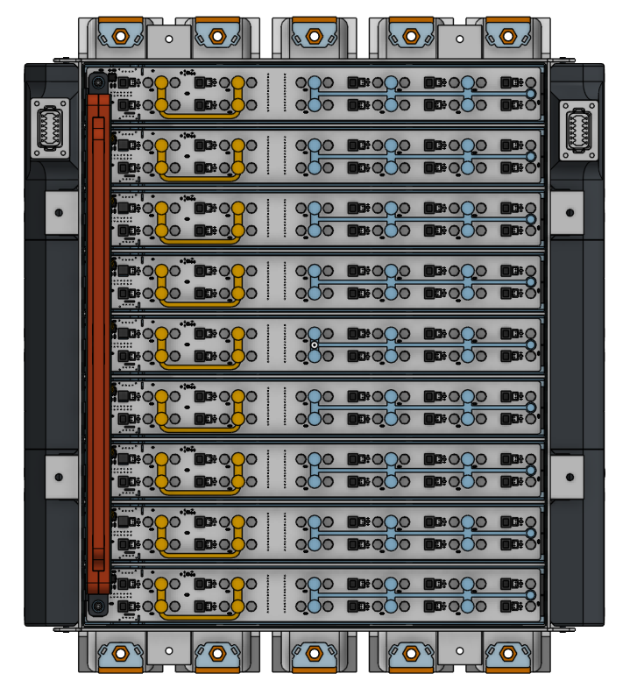
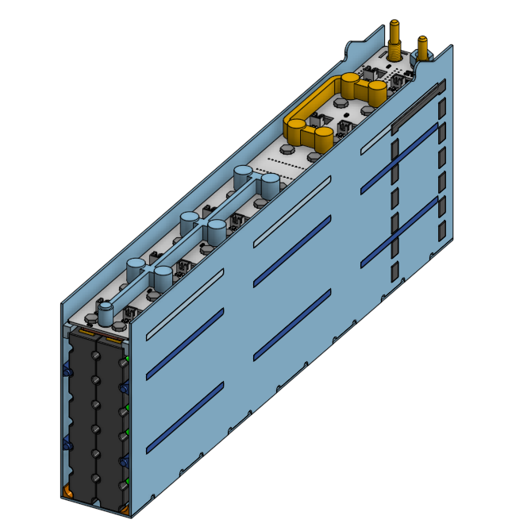
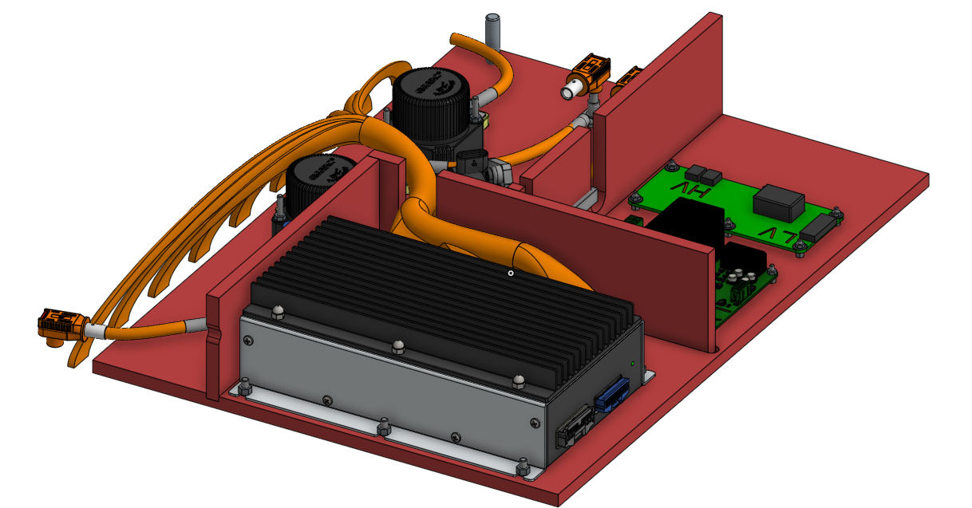
Moment of fault
B
A

Slide 12
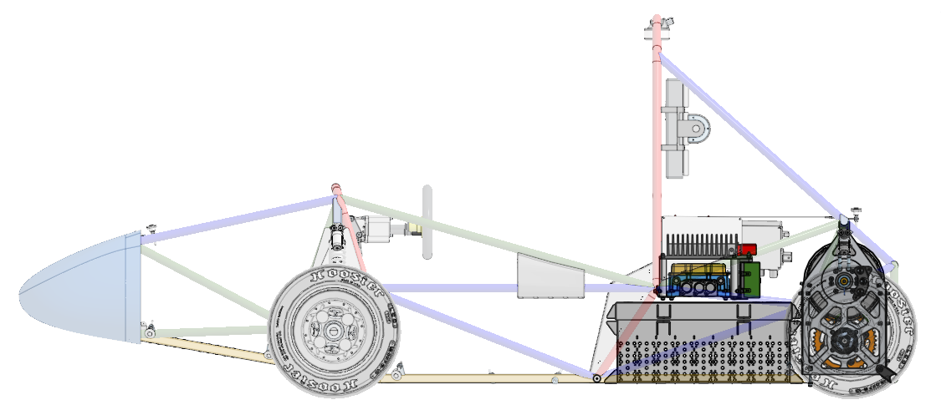
CM200DX Inverter
Powerbox
Accumulator

Slide 13
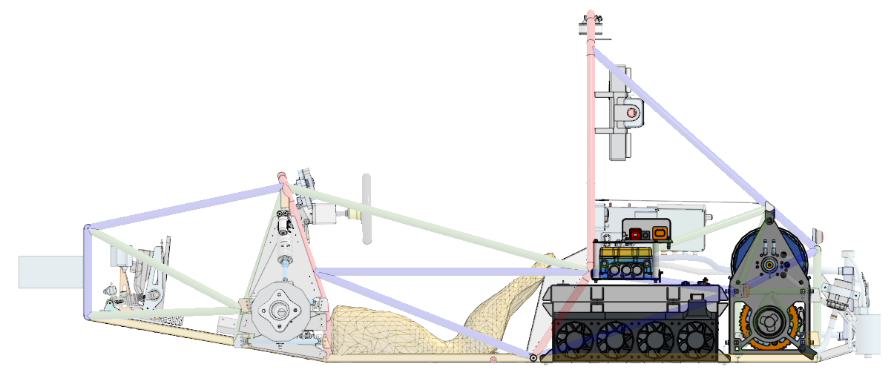
CM200DX Inverter
Powerbox
Accumulator

Slide 14
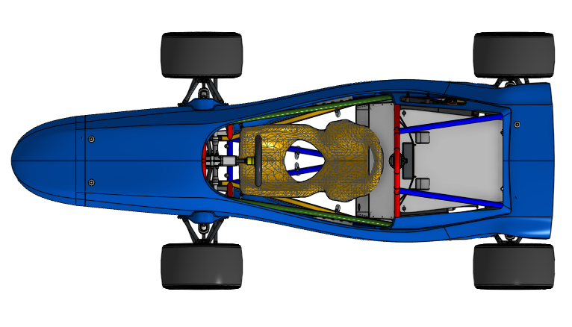
HIP
Accumulator
PEN
DEN
CEN

